Slide 2
.NET Core 3 e i microservizi
Andrea Tosato – Microsoft MVP (Azure)

Slide 3

RELEASED
.NET Core 3.0
WPF and Windows Forms support
Side-by-side support & self-contained EXEs
Full-stack web development with C# and Razor
New C# 8.0 language features
dot.net/get-core3

Slide 4
Novità in .NET Core 3
Per sviluppatori web

Slide 5
Tutte le novità
C# 8.0
Ranges and indices
Async streams
.NET Standard 2.1
Span<T>, ValueTask<T>, Reflection Emit, SIMD
Single-file executables
Assembly linking
Tiered compilation
ReadyToRun images

Slide 6
Tutte le novità
IEEE Floating-point improvements
Fast built-in JSON support
System.Text.Json
HTTP/2 support
TLS 1.3 & OpenSSL 1.1.1 on Linux
Cryptography ciphers
AES-GCM
AES-CCM
Cryptographic Key Import/Export

Slide 7
Tutte le novità
SerialPort for Linux
Docker and cgroup memory Limits
Smaller Garbage Collection heap sizes
Garbage Collection Large Page support
GPIO Support for Raspberry Pi
ARM64 Linux support
Linux
Windows support isn't yet available

Slide 8
<TieredCompilation>false</TieredCompilation>

Slide 9
Single-file executable
<PropertyGroup>
<RuntimeIdentifier>win10-x64</RuntimeIdentifier>
<PublishSingleFile>true</PublishSingleFile>
</PropertyGroup>

Slide 10
<PropertyGroup>
<PublishTrimmed>true</PublishTrimmed>
</PropertyGroup>

Slide 11
ASP.NET Core 3.0
gRPC
High performance contract-based RPC services with .NET
Works across many languages and platforms
Worker Service
Starting point for long running back processes like Windows Server or Linux daemon
Producing or consuming messages from a message queue
Web API’s + Identity
Add security and authentication to Web API’s
Notes:
We’ve added a ton of features to ASP.NET Core in version 3.0 on order to make building resilient microservices easier.

Slide 12
ANNOUNCING
Microsoft Sponsorship for Open Source Projects
gRPC
IdentityServer
Swashbuckle
github.com/grpc
github.com/identityserver
github.com/domaindrivendev/swashbuckle

Slide 13
Healthchecks

Slide 14
ASP.NET Core Healthchecks
Healthchecks
public class BasicStartup
{
public void ConfigureServices(IServiceCollection services)
{
services.AddHealthChecks();
}
public void Configure(IApplicationBuilder app)
{
app.UseRouting();
app.UseEndpoints(endpoints =>
{
endpoints.MapHealthChecks("/health");
});
}
}
Microsoft.AspNetCore.Diagnostics.HealthChecks
https://aka.ms/healthchecks

Slide 15
ASP.NET Core Healthchecks
Healthchecks
public class BasicStartup
{
public void ConfigureServices(IServiceCollection services)
{
services.AddHealthChecks().AddDatabaseChecks();
}
public void Configure(IApplicationBuilder app)
{
app.UseRouting();
app.UseEndpoints(endpoints =>
{
endpoints.MapHealthChecks("/health");
});
}
}
Microsoft.AspNetCore.Diagnostics.HealthChecks https://aka.ms/healthchecks

Slide 16
Docker Images

Slide 17
Docker images
Debian base images
/dotnet/core/aspnet:2.2-stretch-slim 261 MB
/dotnet/core/aspnet:3.0-buster-slim
207 MB
/dotnet/core/runtime:3.0-buster-slim
189 MB
/dotnet/core/runtime:3.0-alpine 88 MB
Alpine base images
/dotnet/core/aspnet:2.2-alpine 166 MB
/dotnet/core/aspnet:3.0-alpine
106 MB
Base address is mcr.microsoft.com

Slide 18
Worker Service
Notes:
There is a new microservices related Worker Service project template for building lightweight background workers, which can be run under orchestrators like Kubernetes.

Slide 19
Worker Service & GenericHost
public static IHostBuilder CreateHostBuilder(string[] args)
{
return Host.CreateDefaultBuilder(args)
.ConfigureServices(hostContext, services) =>
{
services.AddHostedService<Worker>();
});
}
Notes:
Works on a GenericHost. What is a generic host, it’s just that generic. It works in the same pattern as ASP.NET but without anything web specific.
The web host is preconfigured to boot Kestrel, this one is not. All it does is if you have any services in your app that is a Hosted Service, it will run them.
In this snippet, Worker is the service, inherits from BackgroundService but could also inherit from IHostedService.

Slide 20
Windows Service
Worker Service : Windows
public static IHostBuilder CreateHostBuilder(string[] args) =>
Host.CreateDefaultBuilder(args)
.UseWindowsService()
.ConfigureServices((hostContext, services) =>
{
services.AddHostedService<Worker>();
});
Add a NuGet Package Microsoft.Extensions.Hosting.WindowsServices

Slide 21
systemd service
Worker Service : systemd
public static IHostBuilder CreateHostBuilder(string[] args) =>
Host.CreateDefaultBuilder(args)
.UseSystemd()
.ConfigureServices((hostContext, services) =>
{
services.AddHostedService<Worker>();
});
Add a NuGet Package Microsoft.Extensions.Hosting.Systemd

Slide 22
Demo
Notes:
Worker service sidecar.

Slide 23
EndPoint Routing
Notes:
In the microservices world, each services you create does a specific process. In previous versions of .NET or ASP.NET Core specifically MVC was included in order to get the routing.
However, many of the APIs we are developing are just maybe the M and C of MVC or maybe not of the letters.

Slide 24
EndPoint Routing
https://aka.ms/endpointrouting
public class Startup
{
public void ConfigureServices(IServiceCollection services) { }
public void Configure(IApplicationBuilder app, IWebHostEnvironment env)
{
if (env.IsDevelopment())
{
app.UseDeveloperExceptionPage();
}
app.UseRouting();
app.UseEndpoints(endpoints =>
{
endpoints.MapGet("/hello", async context =>
{
await context.Response.WriteAsync("Hello World!");
});
});
}
}
Notes:
Here is a very basic service that just returns HelloWorld on the /hello path. No MVC needed to route or respond to the HTTP request. We saw a similar pattern in the HealthChecks example under the /health route.
Simply add the statement app.UseRouting(); and then app.UseEndPoints and map your routes

Slide 25
https://docs.microsoft.com/it-it/aspnet/core/grpc/comparison?view=aspnetcore-3.0
https://docs.microsoft.com/it-it/aspnet/core/grpc/?view=aspnetcore-3.0

Slide 26
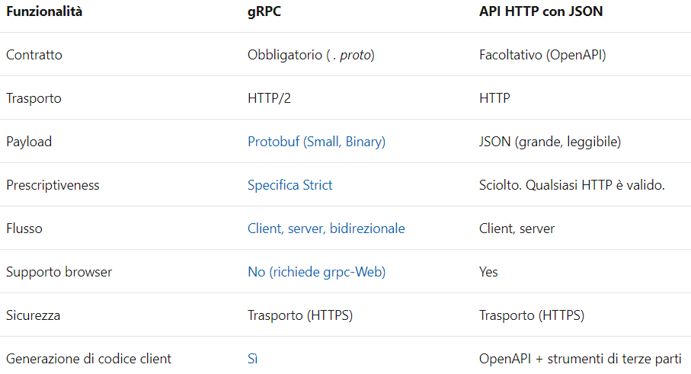
gRPC vs REST vs WCF

Slide 27
.NET Core 3.0 Microservices
DEMO
gRPC

Slide 28
What’s new in SignalR in .NET Core 3.0

Slide 29
Long polling
Client
Server
Request
Response
Event
Request

Slide 30
Server-sent events
Client
Server
new EventSource(…)
Message
Event
Message
Event
Message
Event

Slide 31
WebSockets
Client
Server
upgrade: websocket
HTTP/1.1 101 Switching Protocols
👍
🙂
messages
🙂

Slide 32
Client-to-server Streaming
Notes:
Streaming demos

Slide 33
Server-to-client Streaming
Notes:
Streaming demos

Slide 34

What if the connection…

Slide 35

What if the connection breaks?

Slide 36
Automatic Reconnections

Slide 37
Scale out with Azure SignalR Service

Slide 38
Azure SignalR Service
Offload ASP.NET Core SignalR scale-out to a managed service
Free tier – Up to 20 connections
Pay for “units” of 1,000 connections, up to 100,000 connections
Add NuGet package and 1 line of code

Slide 39
ASP.NET
Core app
Business Logic (Hub)
Pages
SignalR traffic
Client
Web traffic

Slide 40

Azure SignalR Service
ASP.NET
Core app
Business Logic (Hub)
Server Endpoint
Pages
Client Endpoint
Client
Web traffic
SignalR traffic

Slide 41
Demo
Notes:
Worker service sidecar.

Slide 42
Web apps with Blazor

Slide 43
ASP.NET Core 3.0 Blazor
Full stack web development with C#
You don’t need to know AngularJS, React, Vue, etc.
Take advantage of stability and consistency of .NET
Runs in all browsers
Strongly typed on the client and server
Share C# code with the client and server
Web Assembly (In Preview, Release in May 2020)
Native performance
Requires no plugin or code transpilation
Notes:
Blazor is a new client-side web UI framework based on .NET and C# instead of JavaScript.
.NET has always had great support for building server-rendered web apps with ASP.NET, where your .NET code runs on the server and generates HTML & JSON responses. But if you ever wanted to add some client-side functionality to your web app that runs in the browser on the user's device, that meant you had to write some JavaScript.
Well, not anymore! Blazor enables full-stack web development with .NET using only open web standards. .NET Core 3.0 ships support for Blazor Server apps, which enables you to handle client-side UI interactions over a real-time SignalR connection. And in the near future with Blazor WebAssembly you'll be able to run your .NET code directly in the browser on WebAssembly-based .NET runtime.

Slide 44







https://...
JS

Slide 45


Blazor
Build client-side web UI with .NET instead of JavaScript
Write reusable web UI components with C# and Razor
Share .NET code with both the client and the server
Call into JavaScript libraries & browser APIs as needed
C#

Slide 46

How Blazor WebAssembly works
https://...
Razor Components
DOM
.NET
WebAssembly

Slide 47
Blazor on client or server
Blazor WebAssembly
Blazor Server
https://...
https...
.NET Core
Razor Components
DOM
SignalR
DOM
.NET
WebAssembly
Razor Components
.NET
May 2020
.NET Core 3.0

Slide 48
Blazor on client or server
Blazor WebAssembly
Blazor Server
Pro:
True SPA, full interactivity
Utilize client resources
Supports offline, static sites, PWA scenarios
Con:
Larger download size
Requires WebAssembly
Still in preview
Pro:
Smaller download size, faster load time
Running on fully featured .NET runtime
Code never leaves the server
Simplified architecture
Con:
Latency
No offline support
Consumes more server resources
May 2020
.NET Core 3.0

Slide 49
Get started with Blazor
Go to https://blazor.net
Install .NET Core 3.0
Install the Blazor WebAssembly template
(Windows) Install Visual Studio 2019 16.3
(Mac/Linux) Install Visual Studio Code with the C# extension

Slide 50
Blazor
Notes:
Creating components
Using components
Component parameters
Routing
Layouts
Dependency injection
Event handling
Data binding
Forms & validation
JS interop
Use local storage
Using .NET Standard libraries

Slide 51
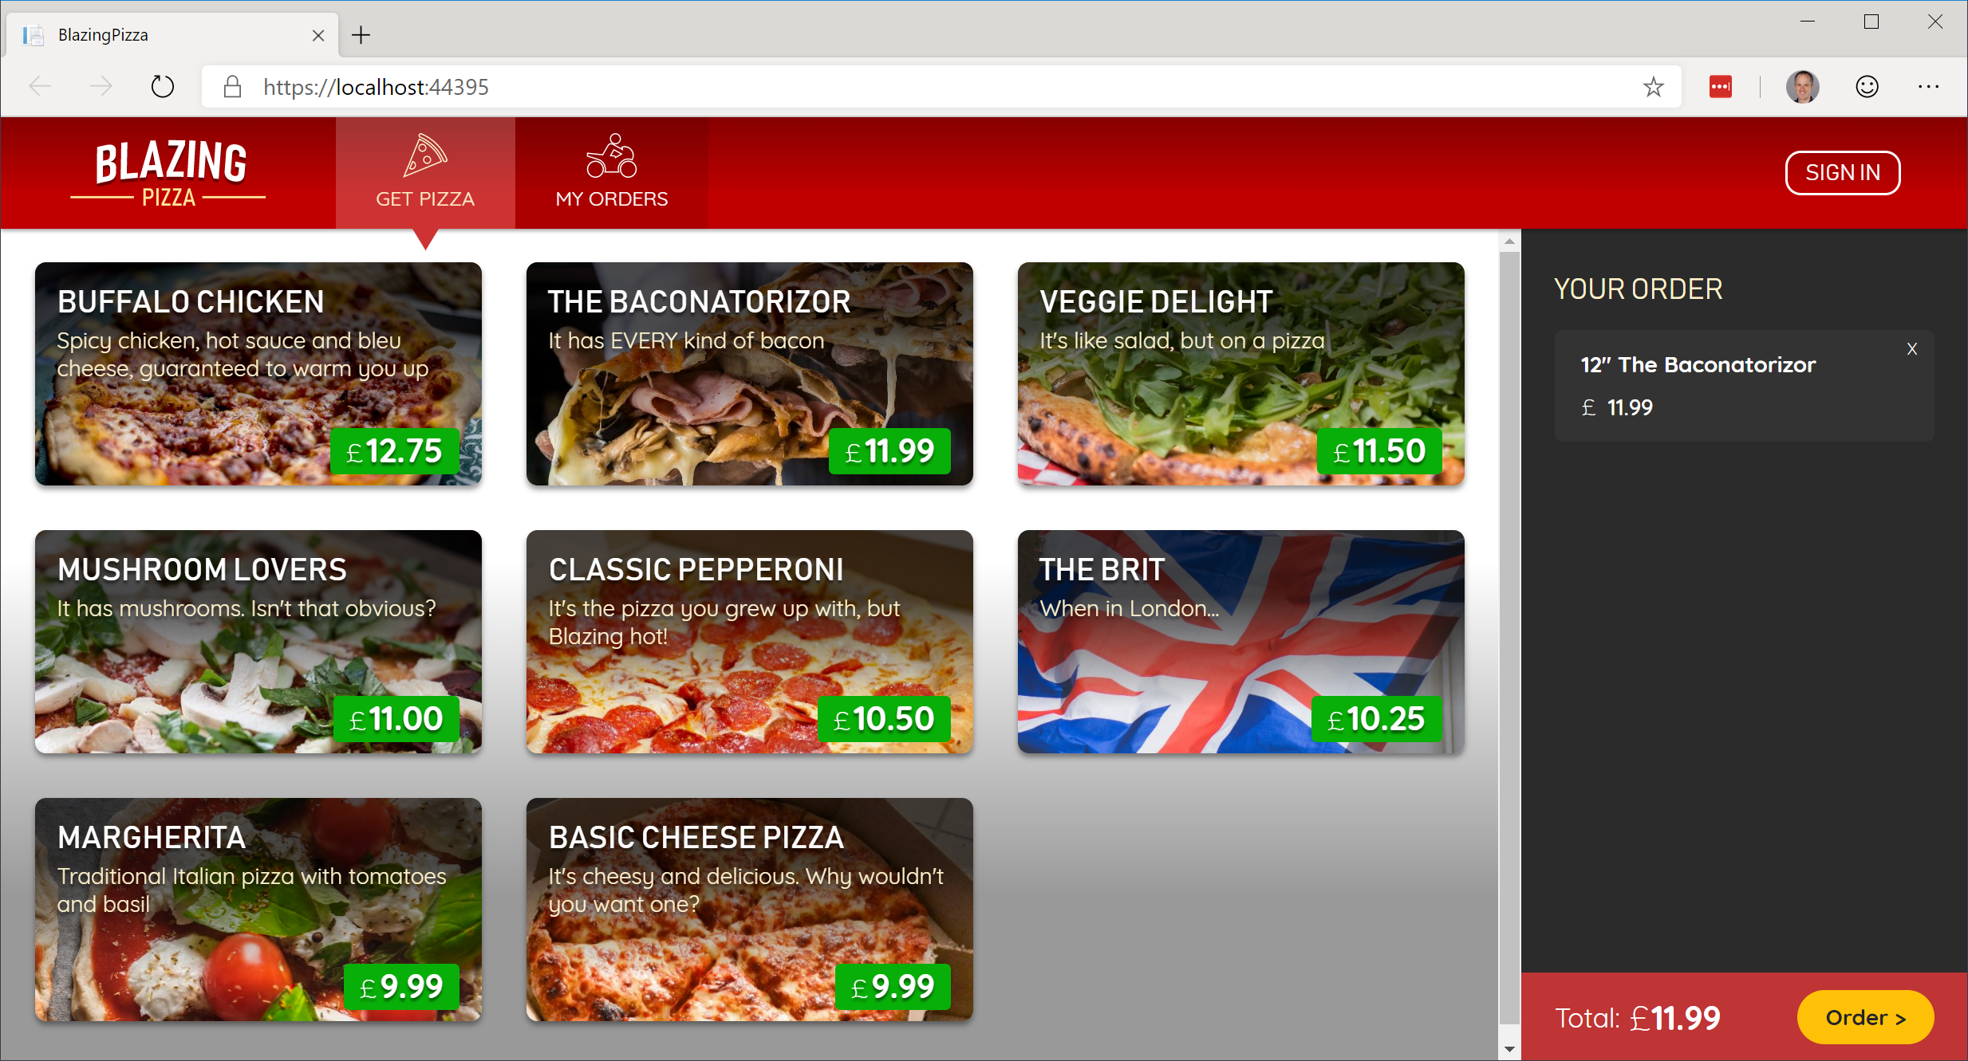
Build your own pizza store UI with Blazor
https://aka.ms/blazorworkshop

Slide 52
The “Awesome Blazor” community
https://aka.ms/awesomeblazor
Free open-source components & JS interop libraries
Lots of fun sample Blazor apps
Articles, videos, blogs, and other learning materials
Chat with the Blazor community on Gitter: https://gitter.im/aspnet/blazor
Thank you, Simon and Chris!

Slide 53
Blasteroids
https://aka.ms/blasteroids

Slide 54
Summary
Blazor Server now available with .NET Core 3.0
Build full-stack web apps with C# and .NET
Rich component model and UI framework
Integrates with existing ASP.NET Core apps
Blazor WebAssembly coming in May 2020

Slide 55
Try Blazor today!
Blazor: https://blazor.net
Docs: https://blazor.net/docs
.NET Core 3.0: https://dot.net/get-core3
Visual Studio: https://visualstudio.com/
Workshop: https://aka.ms/blazorworkshop
Community: https://aka.ms/awesomeblazor

Slide 56
Blazor
DEMO

Slide 57
The Future of Blazor on the Client

Slide 58






So many platforms, so little time…
?

Slide 59
Web
Blazor Server
Web app
Every interaction handled on server
Prerendered HTML (optional)
Blazor WebAssembly
Web app with client-side execution
Loaded from web server
Can work offline via Service Worker
Desktop
+ Mobile

Slide 60
Web
Blazor Server
Web app
Every interaction handled on server
Prerendered HTML (optional)
Blazor WebAssembly
Web app with client-side execution
Loaded from web server
Can work offline via Service Worker
Blazor PWA – OS installed
Appears as native app (own window)
Works offline or online
Desktop
+ Mobile

Slide 61
What is a PWA?
Progress Web App (PWA): A web app that users modern web standards to provide a closer-to-native user experience.
Works offline
Push notifications
Fast & responsive
OS installable

Slide 62
Web
Blazor Server
Web app
Every interaction handled on server
Prerendered HTML (optional)
Blazor WebAssembly
Web app with client-side execution
Loaded from web server
Can work offline via Service Worker
Blazor PWA – OS installed
Appears as native app (own window)
Works offline or online
Blazor Hybrid
Native .NET renders to Electron / WebView
Appears as native app (own window)
Works offline or online
Desktop
+ Mobile

Slide 63
Web
Blazor Server
Web app
Every interaction handled on server
Prerendered HTML (optional)
Blazor WebAssembly
Web app with client-side execution
Loaded from web server
Can work offline via Service Worker
Blazor PWA – OS installed
Appears as native app (own window)
Works offline or online
Blazor Hybrid
Native .NET renders to Electron / WebView
Appears as native app (own window)
Works offline or online
Desktop
+ Mobile
Blazor Native
Same programming model, but
rendering non-HTML UI

Slide 64
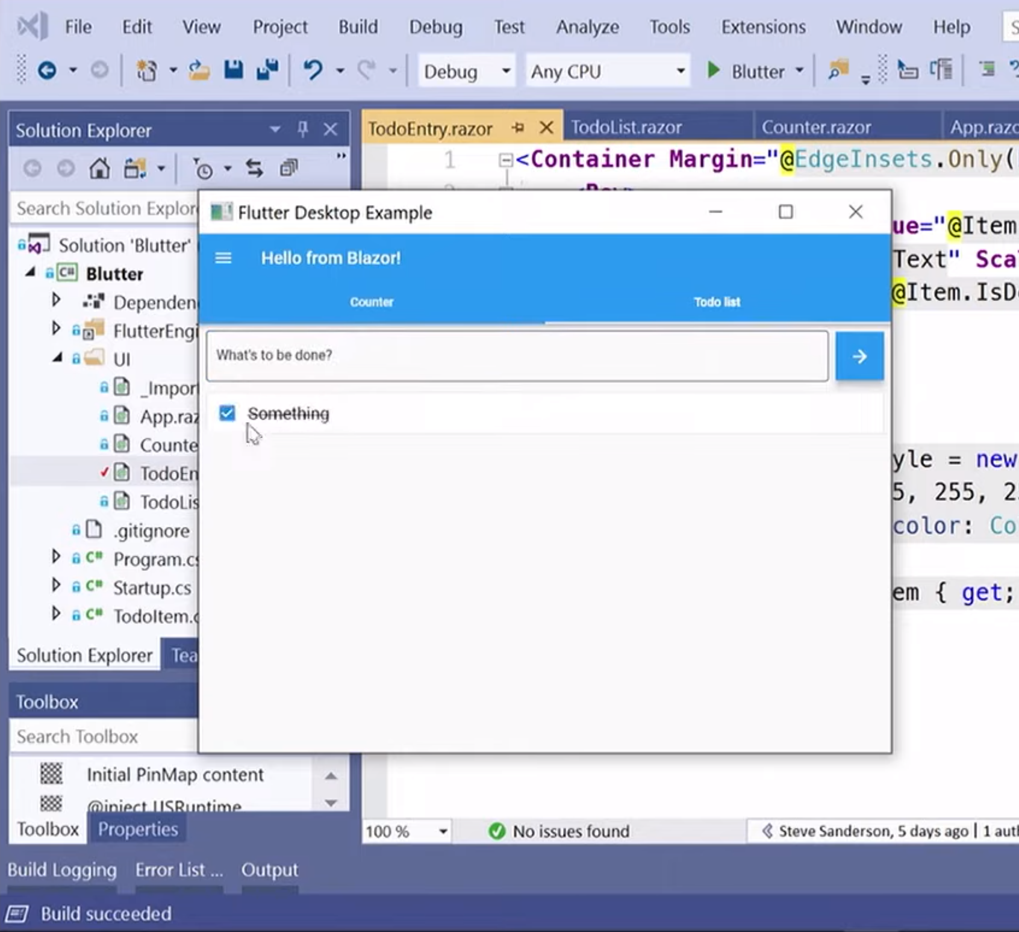
Blazor Native
By default, Blazor renders to HTML
But the rendering layer is replaceable
Possible to render to native controls instead
Currently exploring different options
https://aka.ms/blutter

Slide 65
Blazor roadmap
Blazor Server – Shipped with .NET Core 3.0!
Blazor WebAssembly – May 2020
Blazor PWA & Electron – Previews with .NET 5
Blazor Native – Under investigation

Slide 66
.NET 5

Slide 67
.NET 5
.NET
.NET FRAMEWORK
.NET CORE
.NET
XAMARIN / MONO
Runtime (JIT & Native)
Runtime
Runtime
Runtime
One Base Class Library
Base Class Library
Core Library
Mono Class Library
.NET STANDARD
Notes:
2019 – Introduce .NET 5 – Windows, Mac, Linux, Android, IOS all run .NET Core’s runtime
Same BCL used on all platforms, same runtime used on all platforms
Native code compilation on all platforms, by merging .NET Native and Mono AOT
JIT and AOT Runtime
.NET 5 is the next major version of the .NET Platform that brings technologies from .NET Framework, .NET Core and & Mono runtimes and frameworks together into one .NET platform.
.NET 5 will have one Base Class Library (BCL) that will contain APIs for building any type of application. All .NET workloads are supported with application frameworks including cross-platform web development with ASP.NET, iOS and Android mobile development with Xamarin, Windows Desktop, and cross-platform IoT.
.NET 5 will have both Just-in-Time (JIT) and Ahead-of-Time (AOT) compilation models for the multiple compute and device scenarios it must support. JIT has better performance for server and desktop workloads as well as development environments. AOT has better startup, a small footprint, and is required for mobile and IoT devices.
.NET 5 will also have one unified toolchain supported by new SDK project types, will have a flexible deployment model (Side-by-Side and self-contained EXEs) and continue .NET Core's superior performance for server & cloud workloads.

Slide 68
.NET Schedule
July 2019
.NET Core 3.0
RC
Sept 2019
.NET Core 3.0
Nov 2019
.NET Core 3.1
LTS
Nov 2020
.NET 5.0
Nov 2021
.NET 6.0
LTS
Nov 2022
.NET 7.0
Nov 2023
.NET 8.0
LTS
.NET Core 3.0 released today!
.NET Core 3.1 = Long Term Support (LTS)
.NET 5.0 release in November 2020
Major releases every year, LTS for even numbered releases
Predictable schedule, minor releases if needed

Slide 69














Download .NET Core 3.0 Today!
dot.net/get-core3
visualstudio.com/downloads
DESKTOP
WEB
CLOUD
MOBILE
GAMING
IoT
AI
.NET

Slide 70
New free e-books
https://dotnet.microsoft.com/learn/dotnet/architecture-guides

